Slide 1
ShareShare
Web Programming(002) Final-term Team Project
: The Group Purchase Platform
Team. <TAG>
최락원, 김민수, 유종혁, 이은서, 이은지, 변승진

Slide 2
1
Our Previous Project
2
What Features we included?
CONTENTS
3
Explanation about pages & codes
4
Team TAG’s Effort and Development Process

Slide 3


What’s ShareShare?
A community of group purchase
Purpose
To make it possible for individuals to purchase goods at lower prices than when they purchase goods alone by using group purchase.

Slide 4
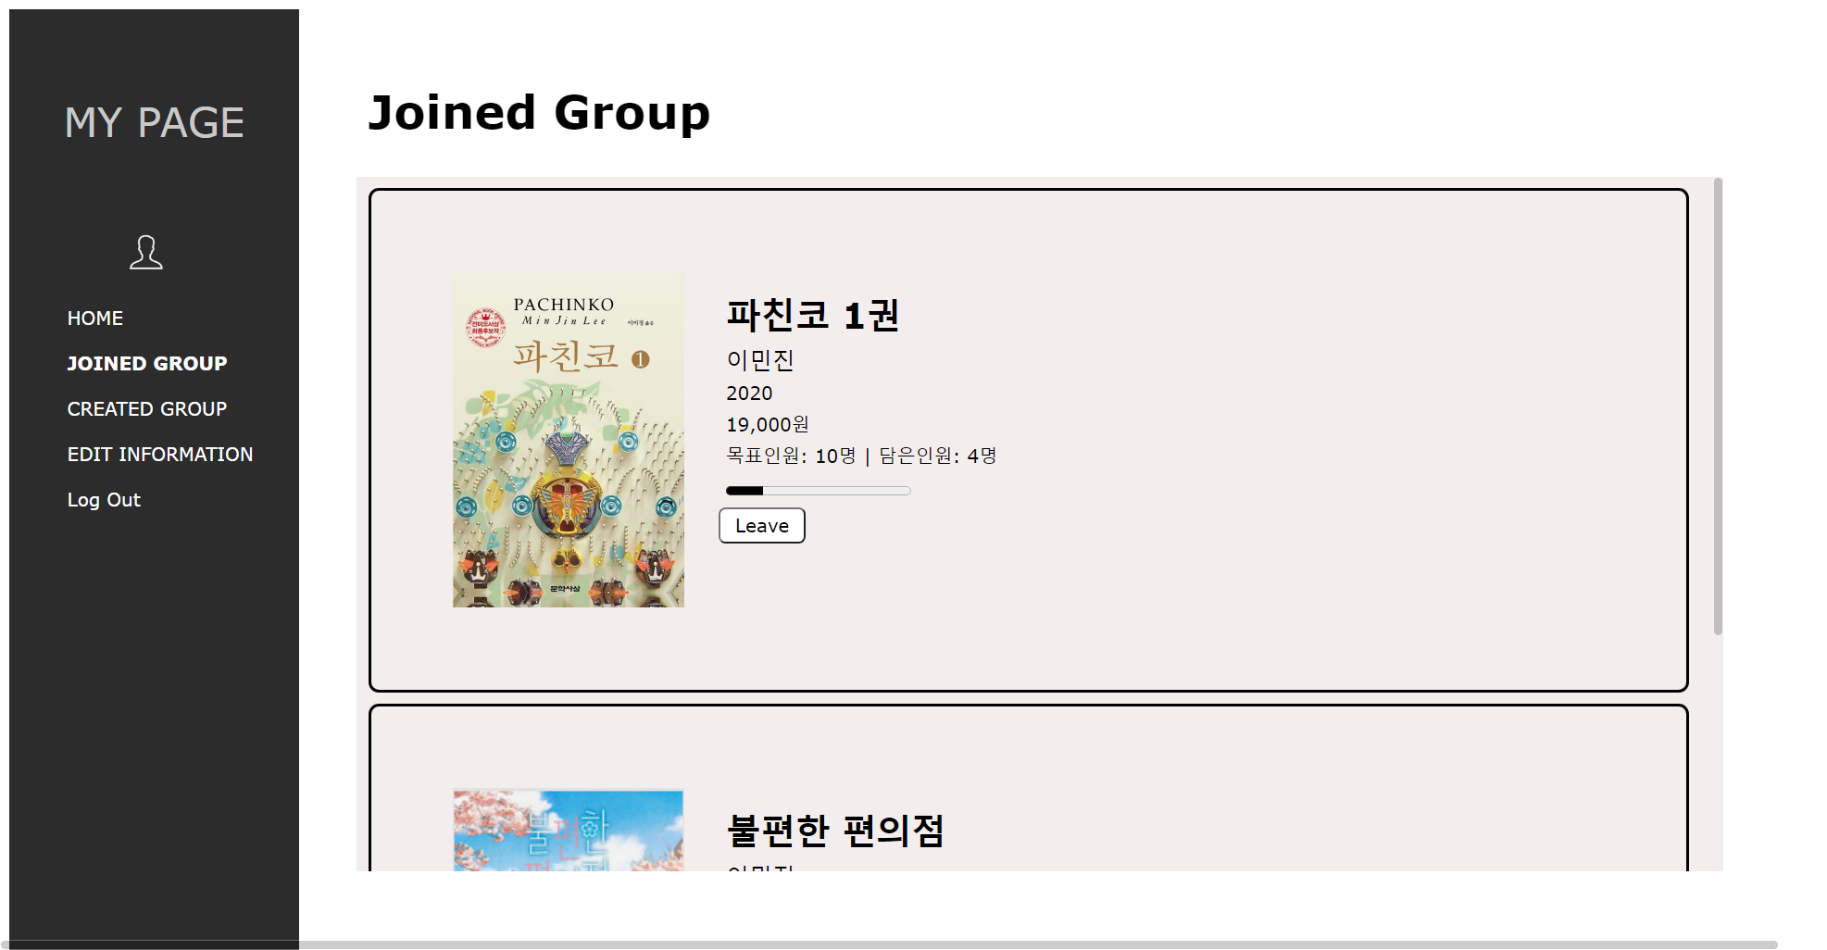
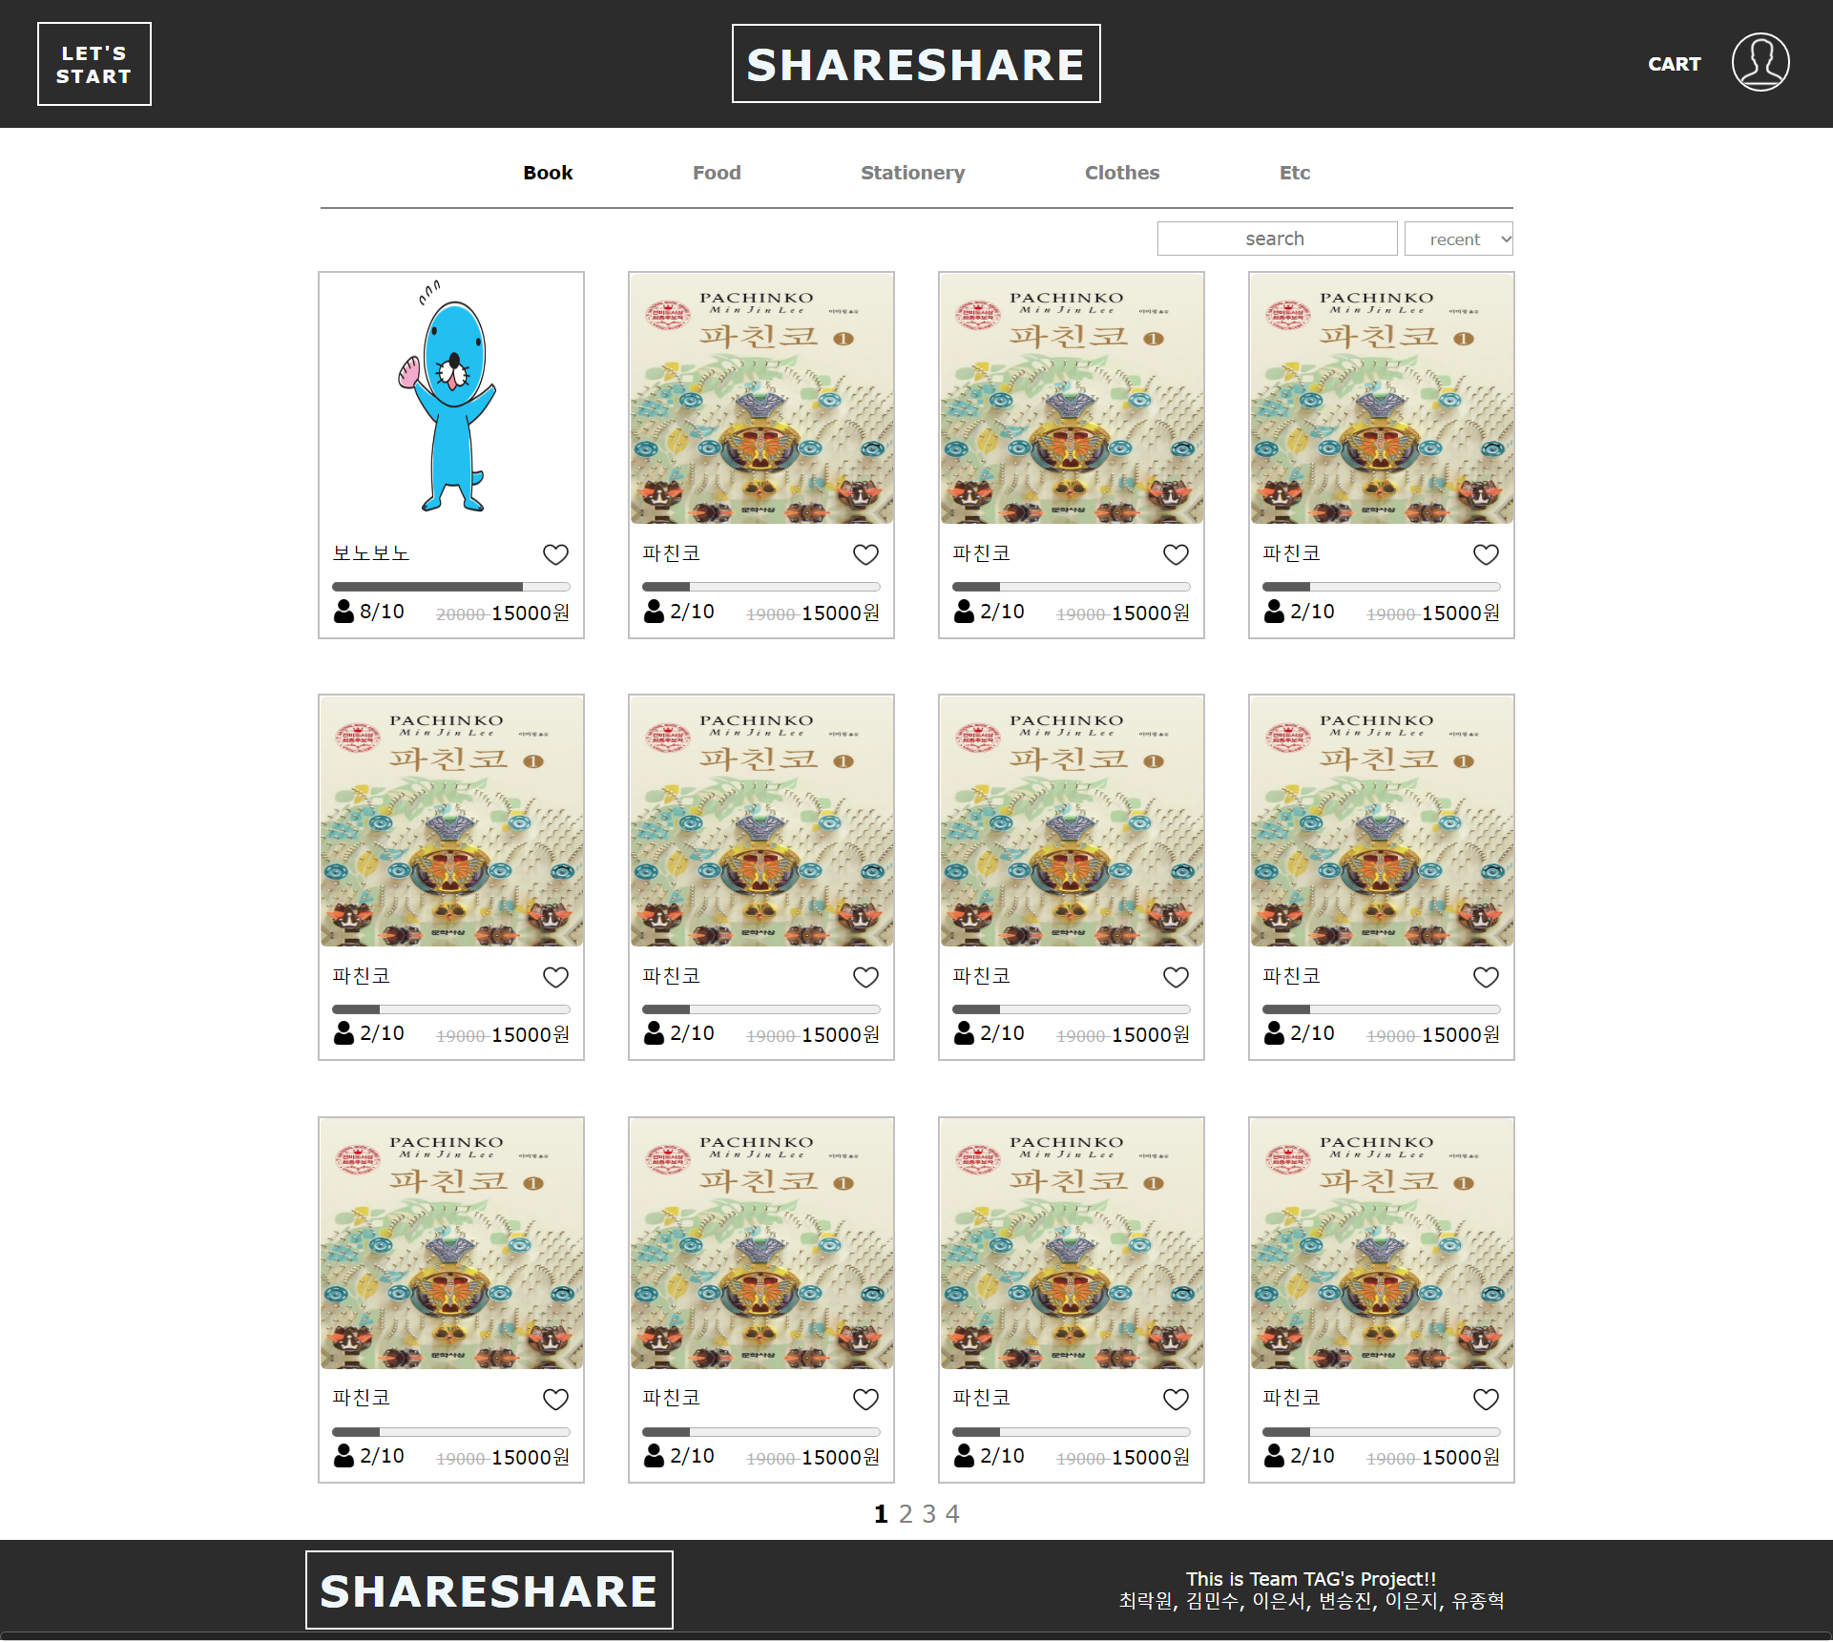
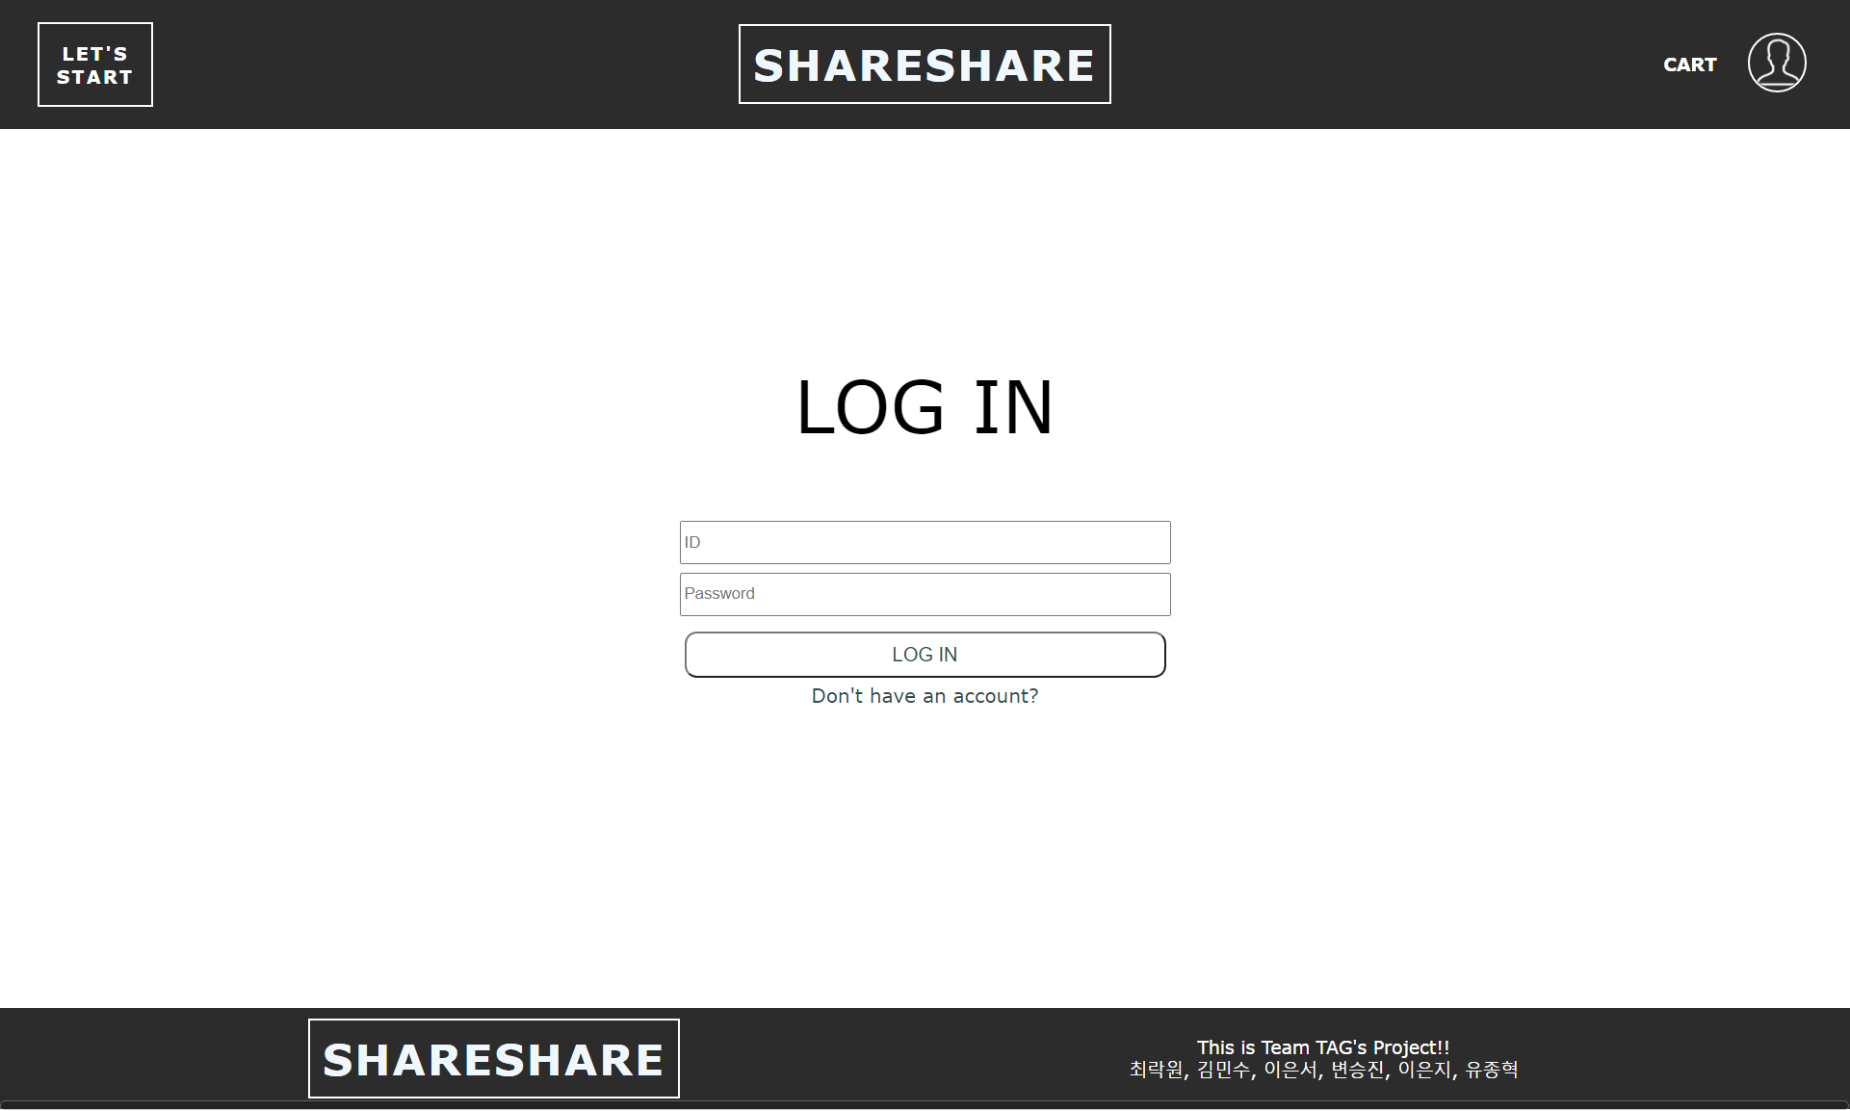
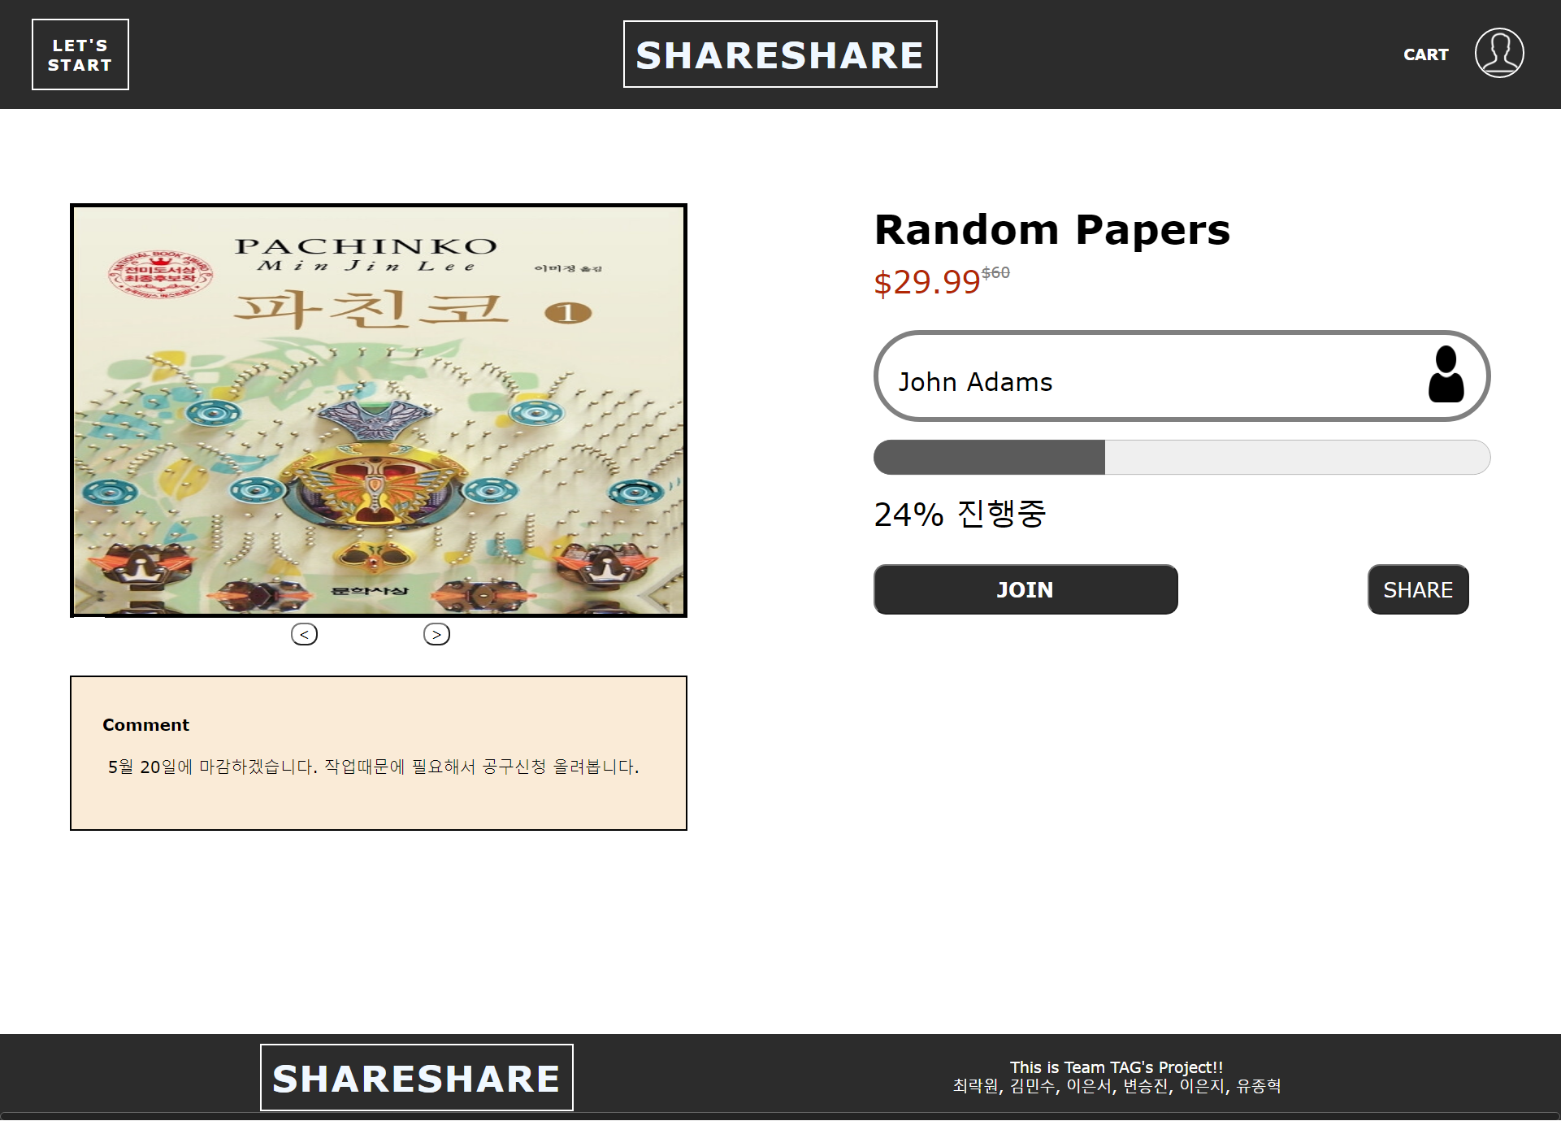
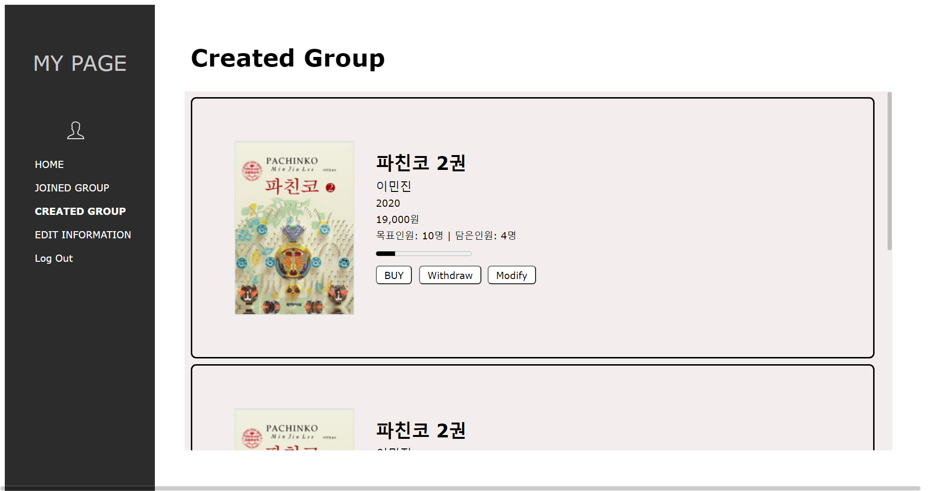
At Mid-term Project…
We have to develop back-end side!

Slide 5

ShareShare-상세 페이지
Implement of New Features
ShareShare-헤더, 메뉴 바
Features what we added :
Log in & Log out
Sign in
Making group purchase by myself
Image upload
Join or disjoin the group
Counting joined person’s number
Like button
Paging
Sorting
Searching
Modifying my created & joined group
Editing my account information

Slide 6
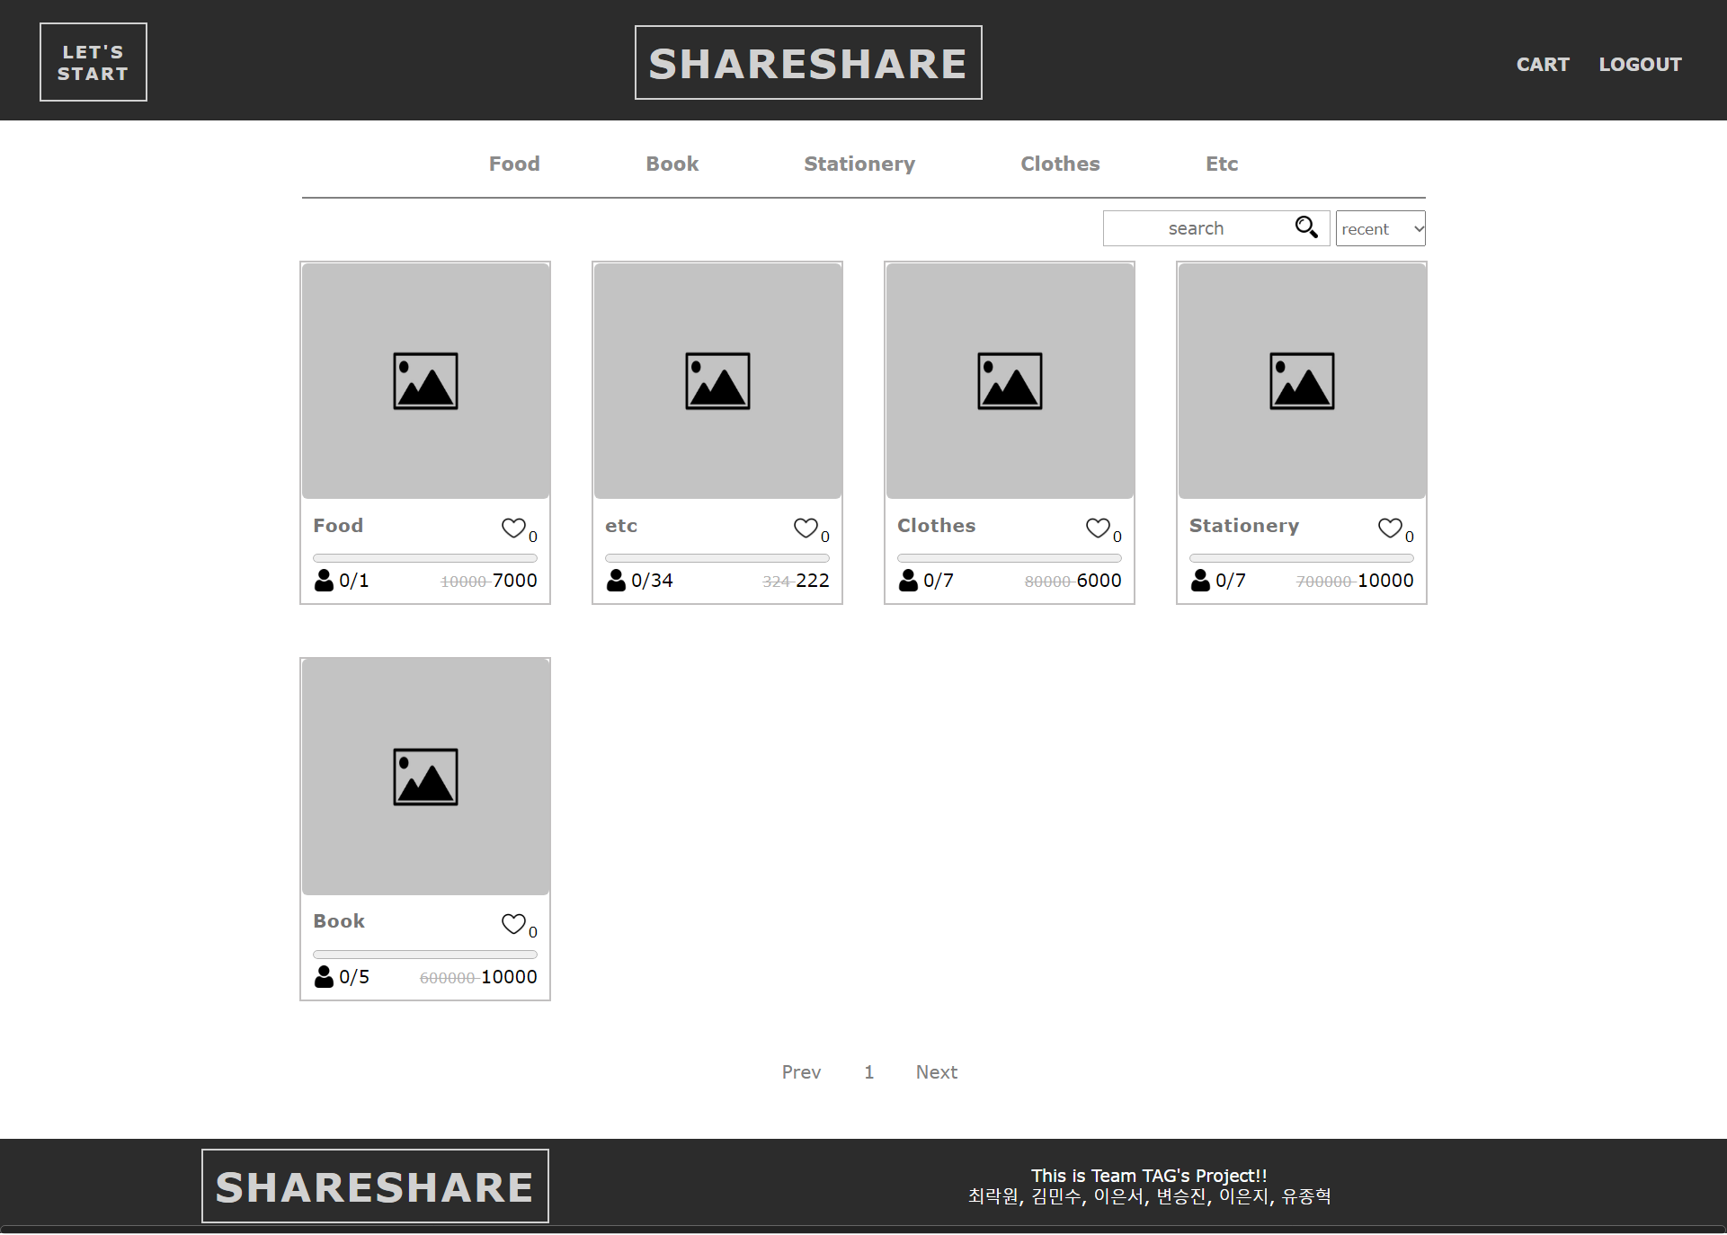

ShareShare-상세 페이지
ShareShare – Intro Page
ShareShare-헤더, 메뉴 바
Intro page
Function
It takes user to the main page.

Slide 7
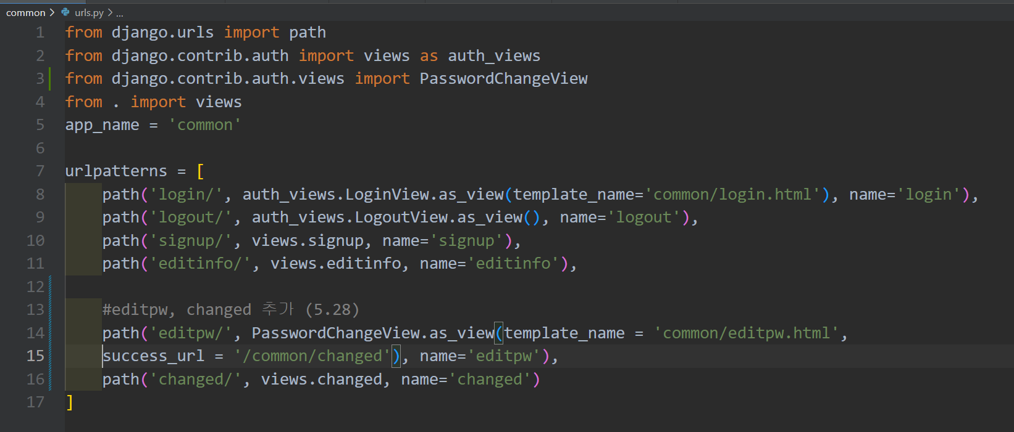
ShareShare-상세 페이지
Codes - urls
ShareShare-헤더, 메뉴 바

Slide 8
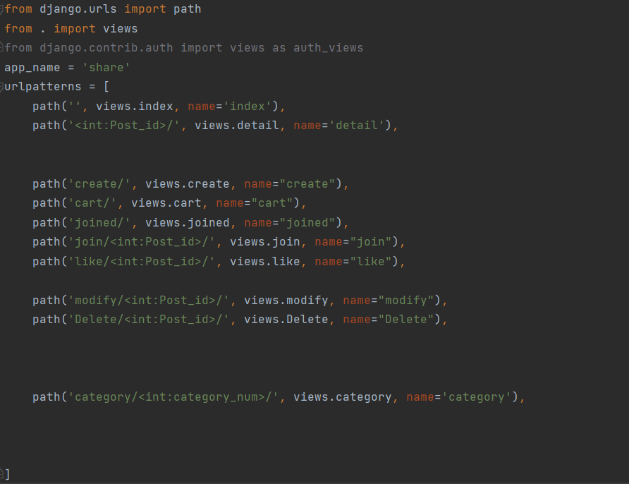
ShareShare-상세 페이지
Codes - urls
ShareShare-헤더, 메뉴 바

Slide 9
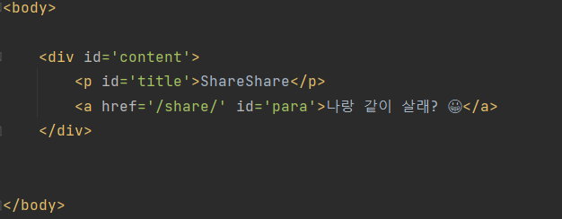
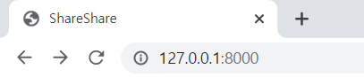
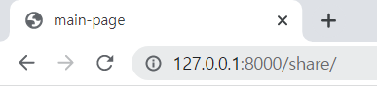
ShareShare-상세 페이지
ShareShare – Intro Page
ShareShare-헤더, 메뉴 바
share/firstPage.html
▲ Intro page
▲ Main page

Slide 10
ShareShare-상세 페이지
ShareShare – Main Page
ShareShare-헤더, 메뉴 바
Main page
The Main page shows a list of products, navigation bar, search window, and sorting option.
Function
Searching : user can search the product by insert some words.
Sorting : user can sort products to other options
(recent, like, Top price, Low price)
Paging : if the number of products bigger than eight,
main page can shows other products to
next page or previous page.

Slide 11
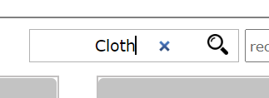
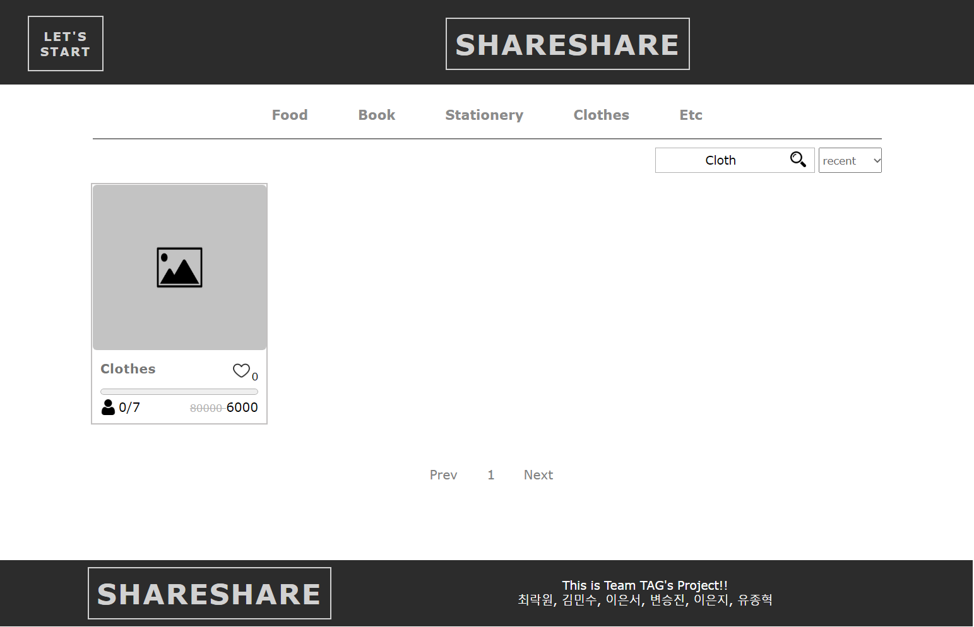
ShareShare-상세 페이지
ShareShare – Main Page(searching)
ShareShare-헤더, 메뉴 바
ex)

Slide 12
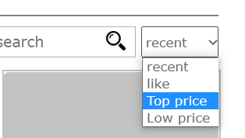
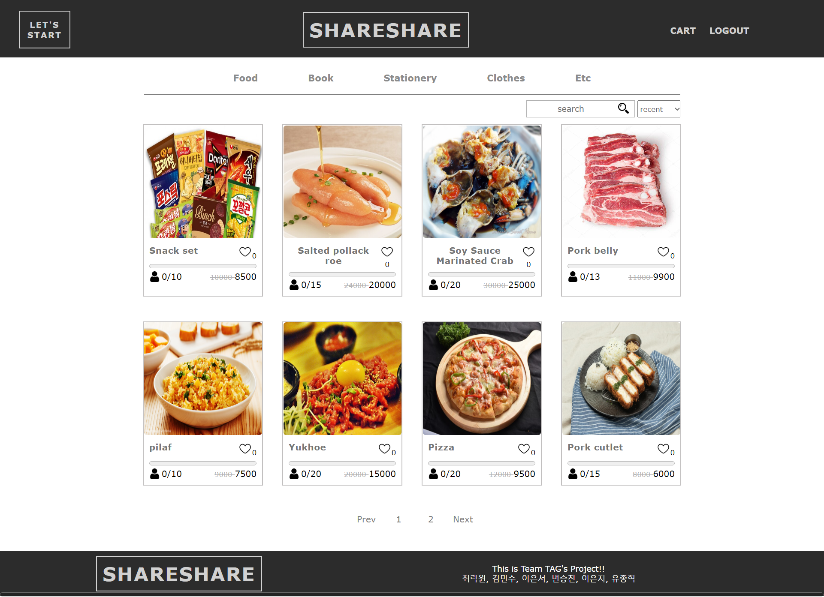
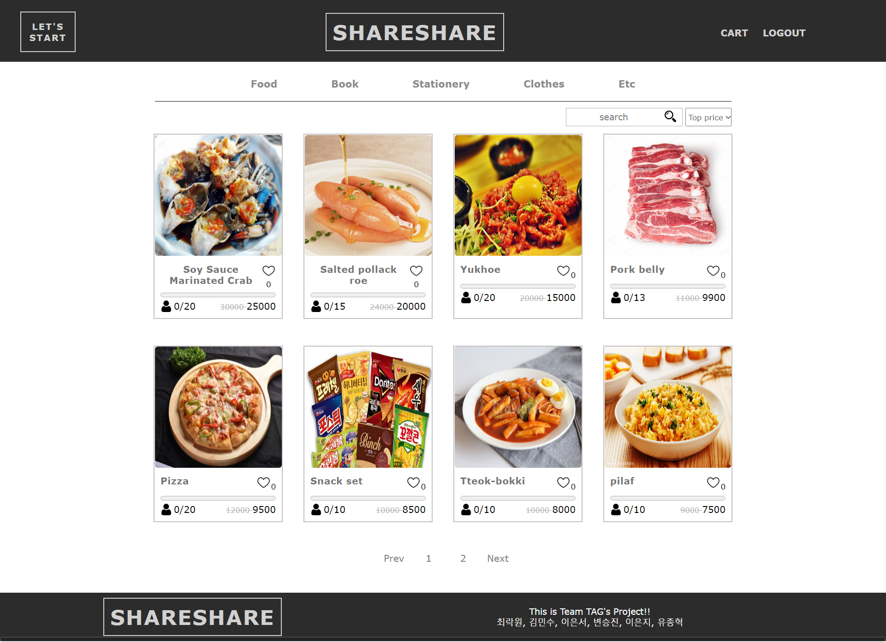
ShareShare-상세 페이지
ShareShare – Main Page(sorting)
ShareShare-헤더, 메뉴 바
ex)

Slide 13
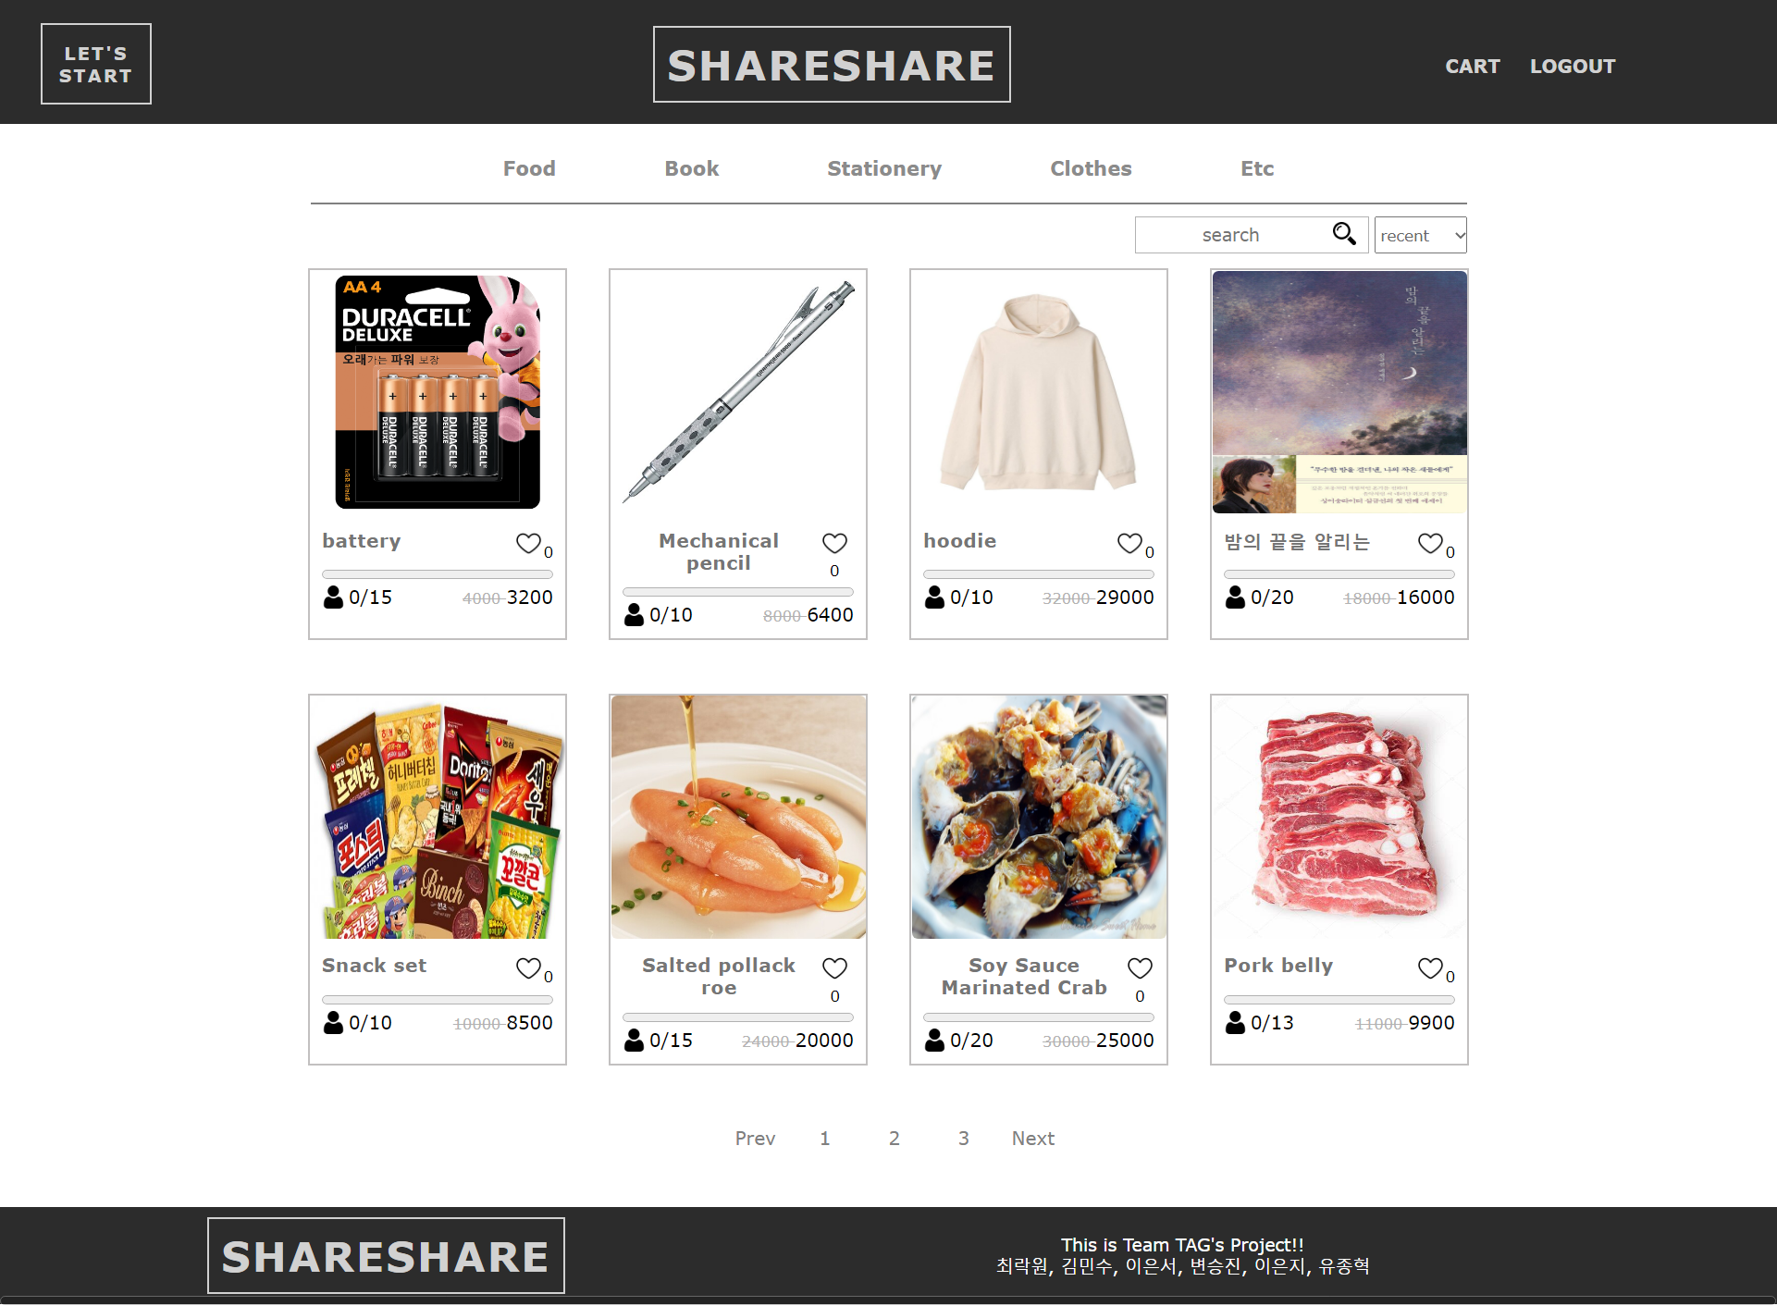
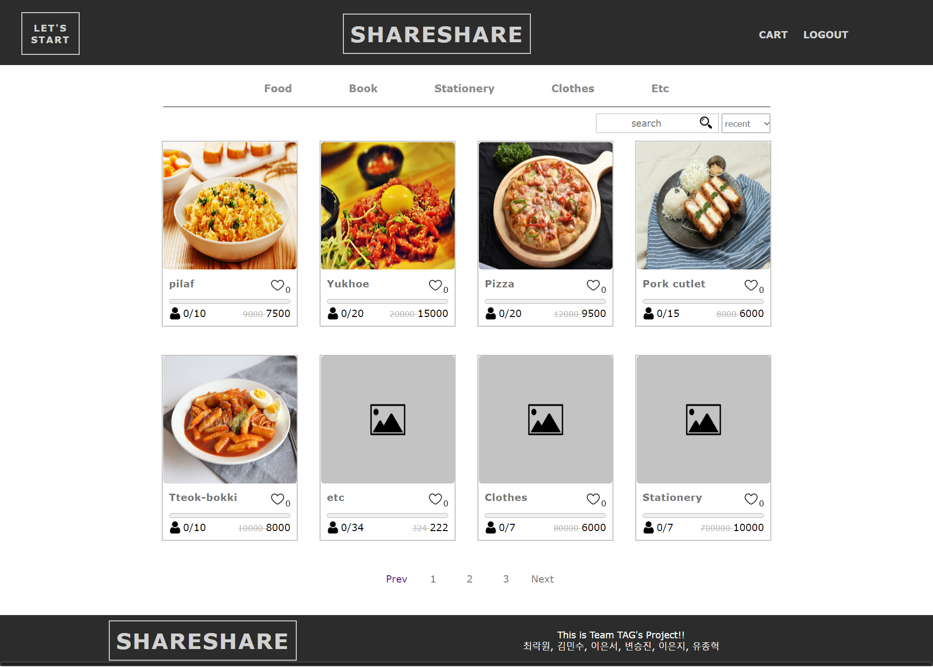
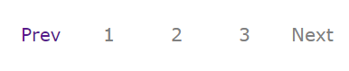
ShareShare-상세 페이지
ShareShare – Main Page(paging)
ShareShare-헤더, 메뉴 바
ex)
▲ Page 1
▲ Page 2

Slide 14
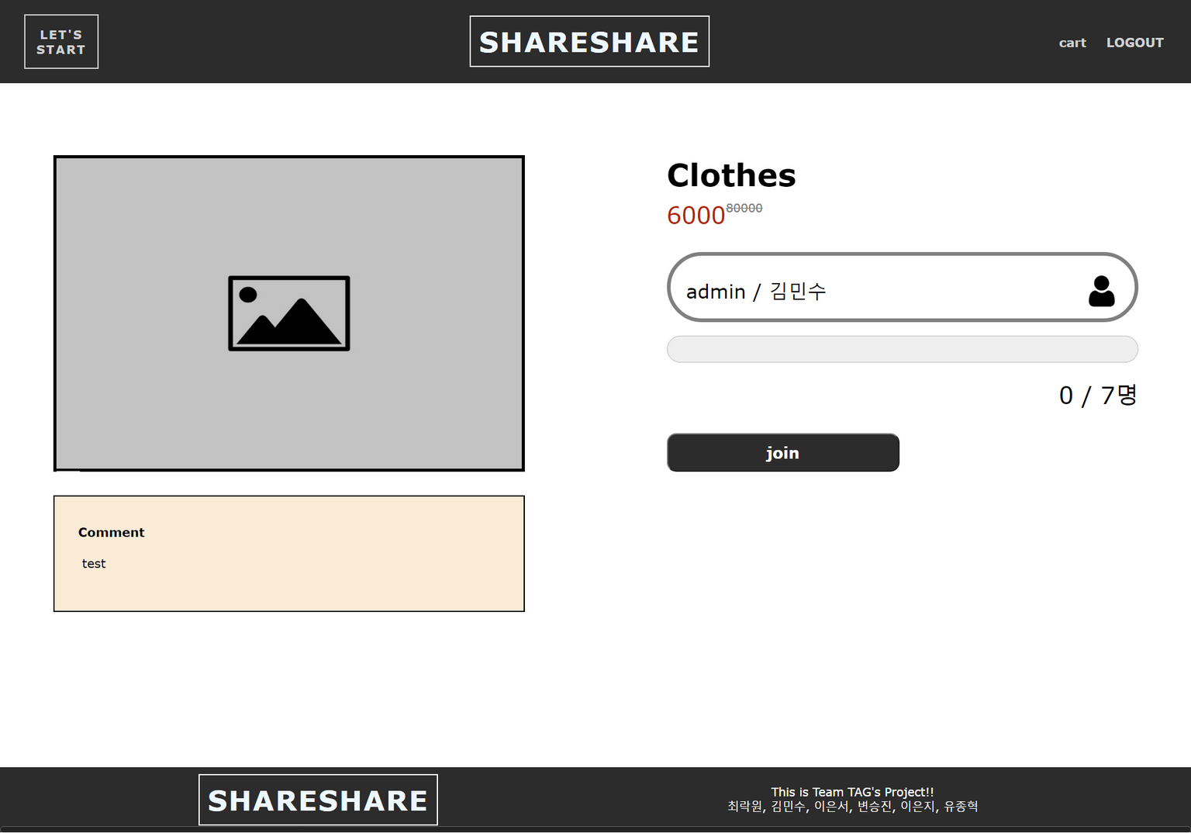
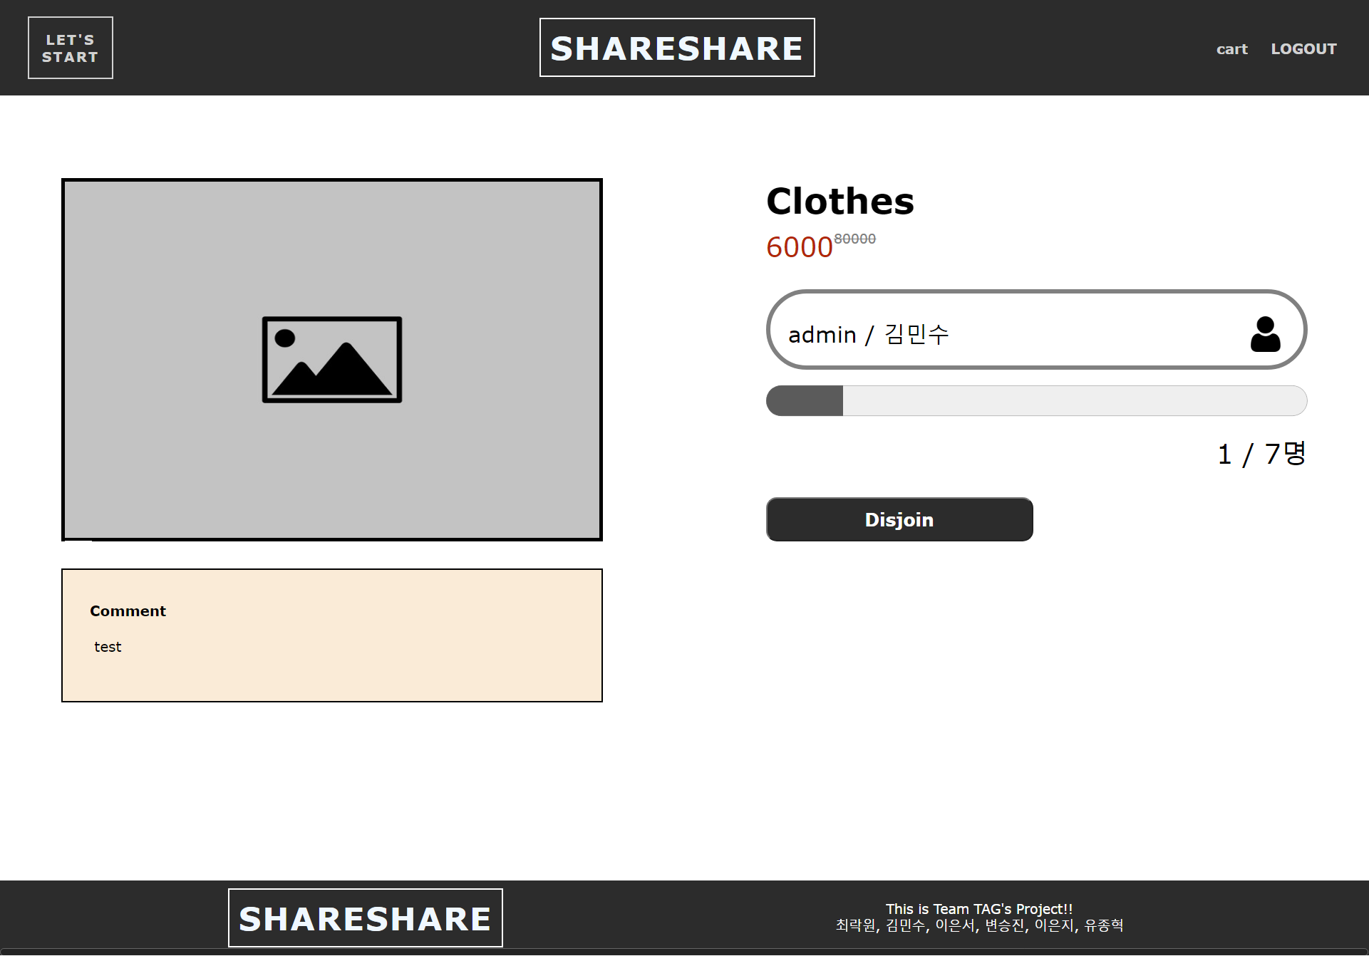
ShareShare-상세 페이지
ShareShare – Product Information
ShareShare-헤더, 메뉴 바
Info page
The Info page shows a description of the product, Group leader information, and a degree of participation.
Function
If user click the ‘Join’ button, the number of members is increased, and button changed to the ‘Disjoin’ button.

Slide 15
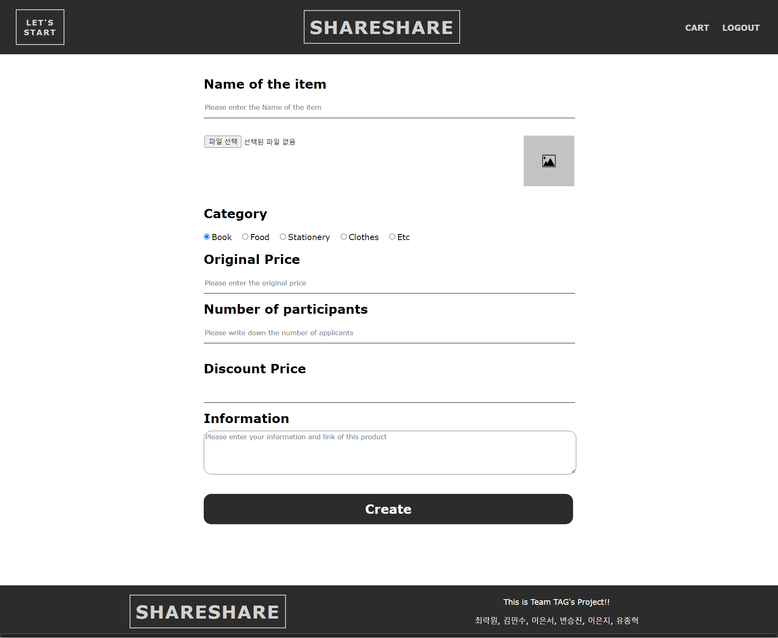
ShareShare-등록 페이지
ShareShare – Making group
ShareShare-헤더, 메뉴 바
Group page
If user want, user can be leader of group and create group to open group purchase.
Function
User can put the information about products : name, price, number of participants, and additional information or comments.
User also can upload product image at this page.

Slide 16
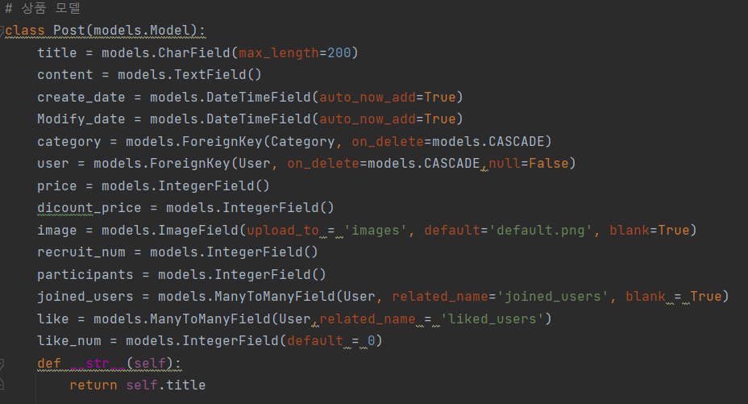
ShareShare-상세 페이지
Codes – product model
ShareShare-헤더, 메뉴 바
Product post
title
content
date
Create_date
Modify_date
user
price
(Original) Price
Discount Price
Image
Recruit member
member
Participants
Like button
Joined users
like
Like number

Slide 17
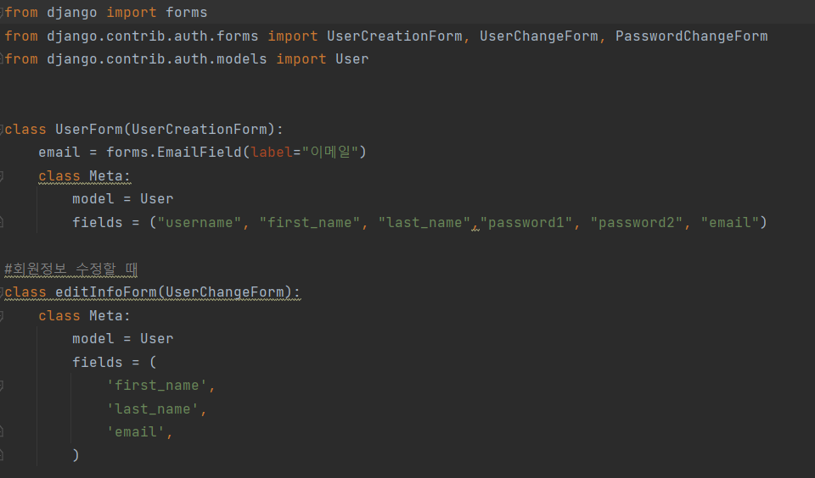
Codes – User model
User
First Name
ID
Last Name
email
PW

Slide 18
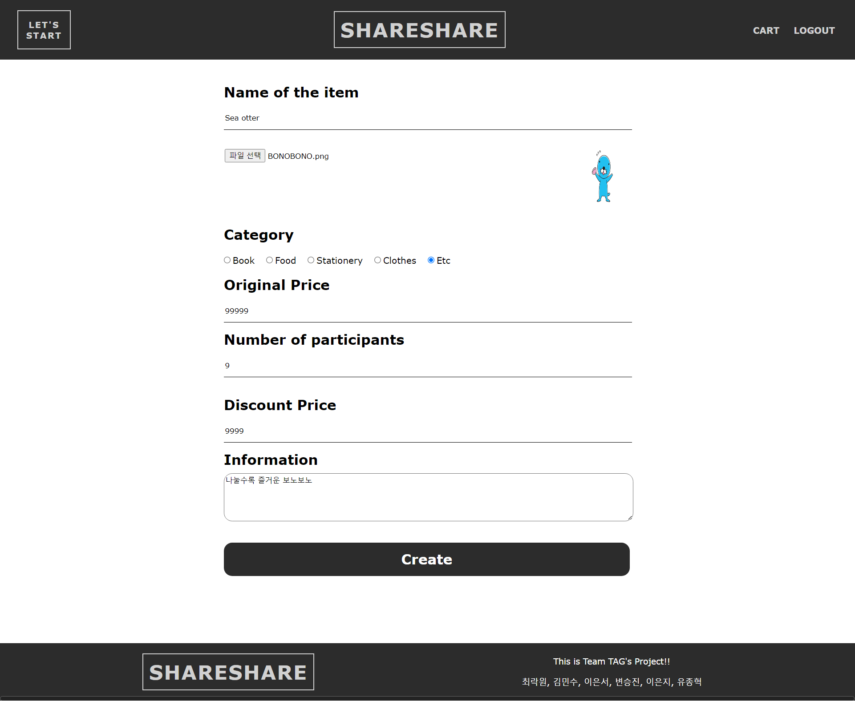
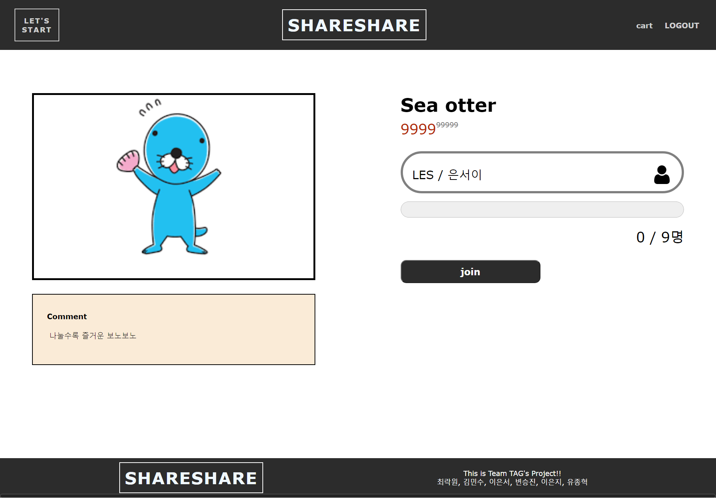
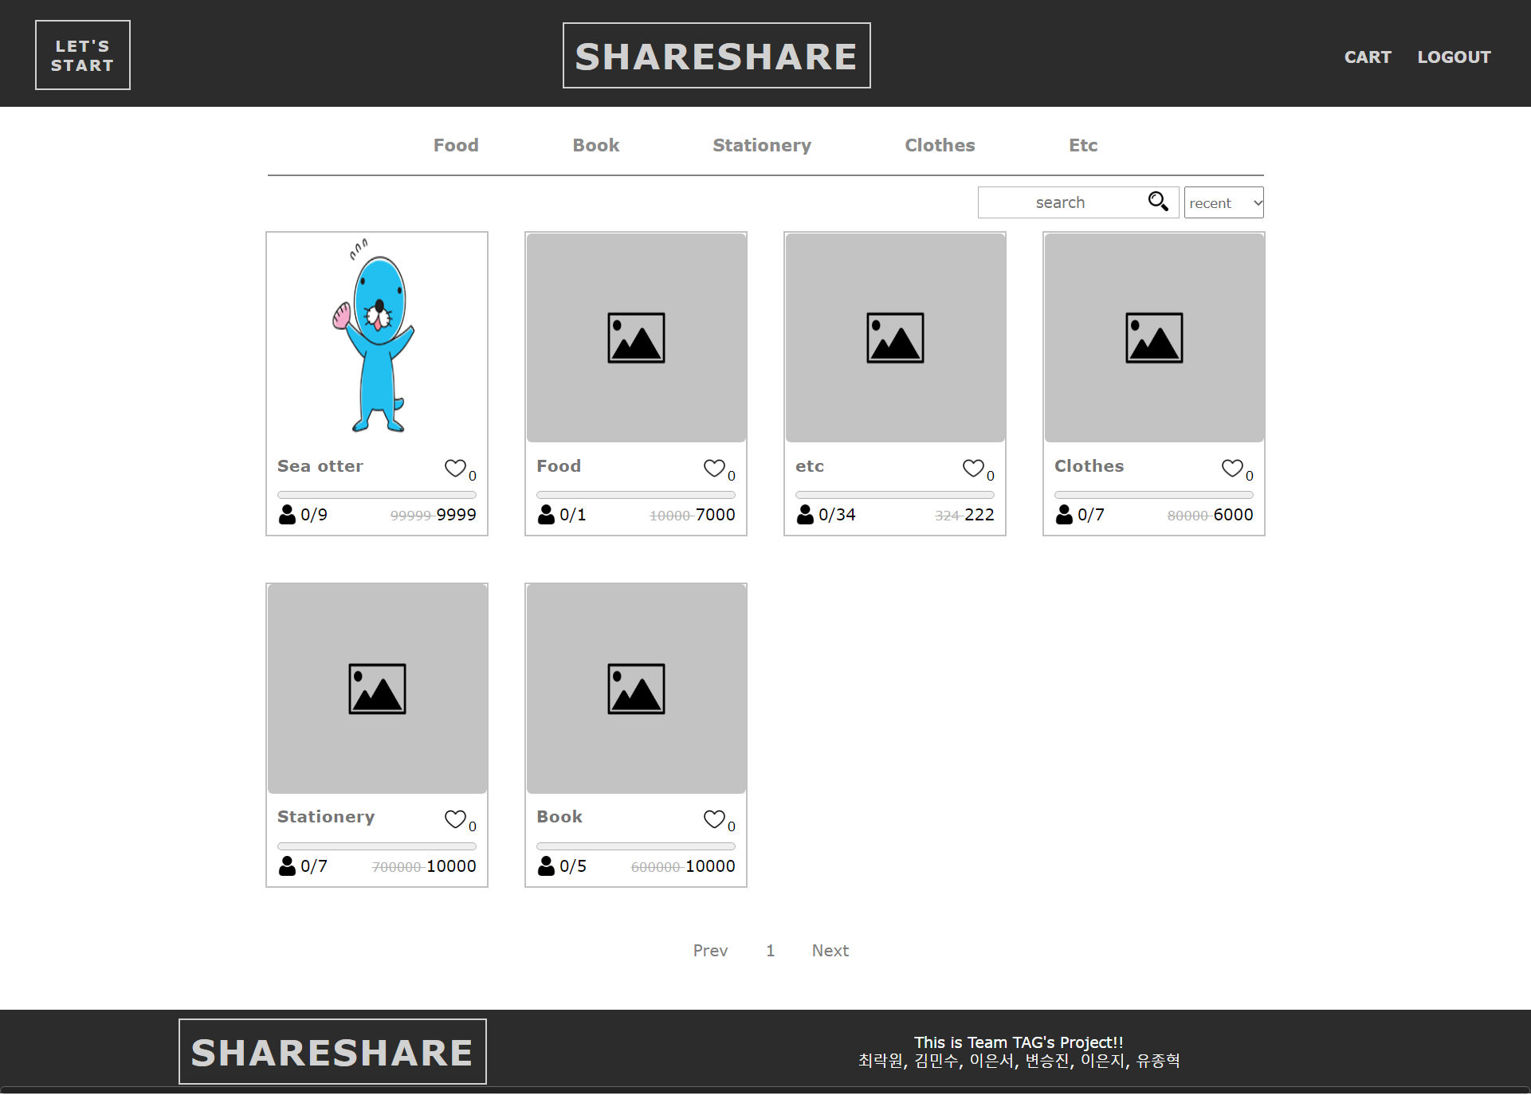
ShareShare-등록 페이지
ShareShare – Making group
ShareShare-헤더, 메뉴 바

Slide 19
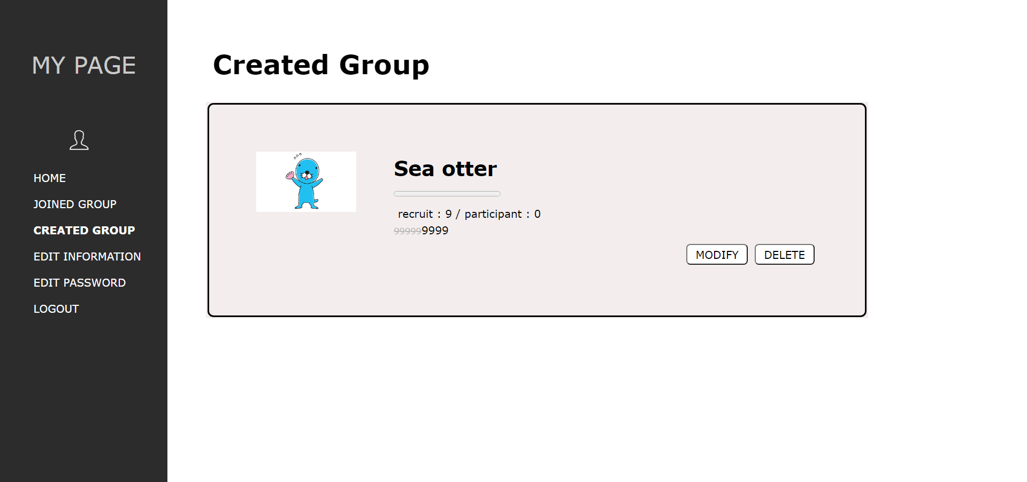
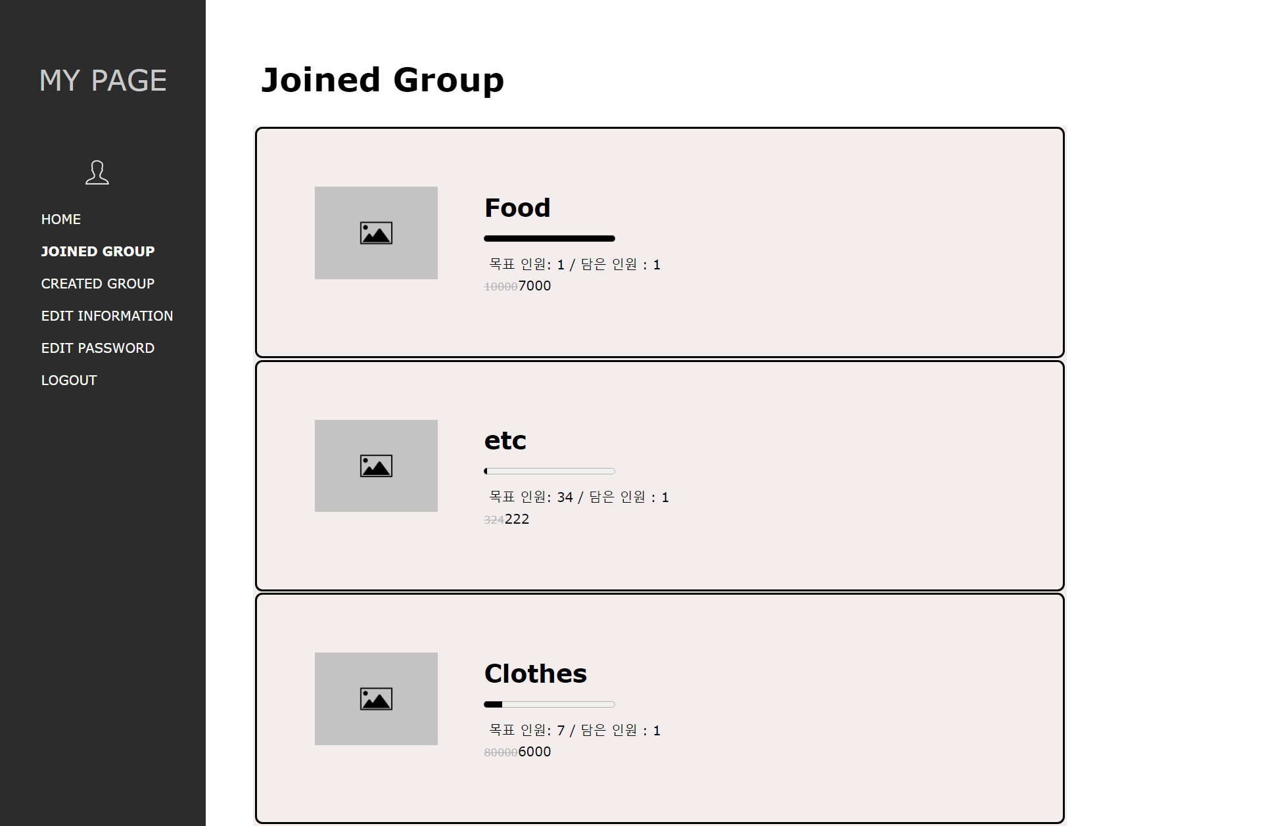
ShareShare-마이페이지
ShareShare – My page : Group Info

Slide 20
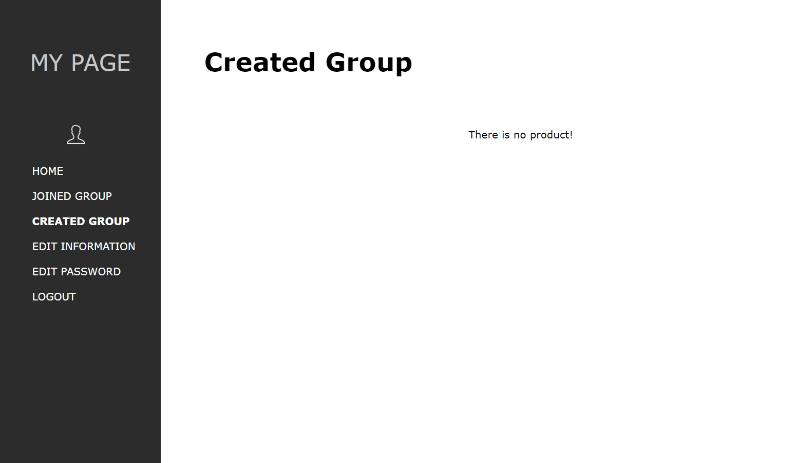
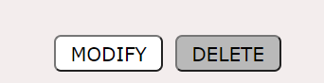
ShareShare-마이페이지
ShareShare – My page : Created Group
Group cart
User can view a list of groups that they created on the My page.
Function
User can modify group information, or delete the group.
If there is no group, “There is no product” is displayed.

Slide 21
ShareShare-마이페이지
ShareShare – My page : Joined Group
Group cart
User can view a list of groups that they joined on the My page.
Function
Joined Group : User can check one’s joined group.
If there is no group, “There is no product” is displayed.

Slide 22
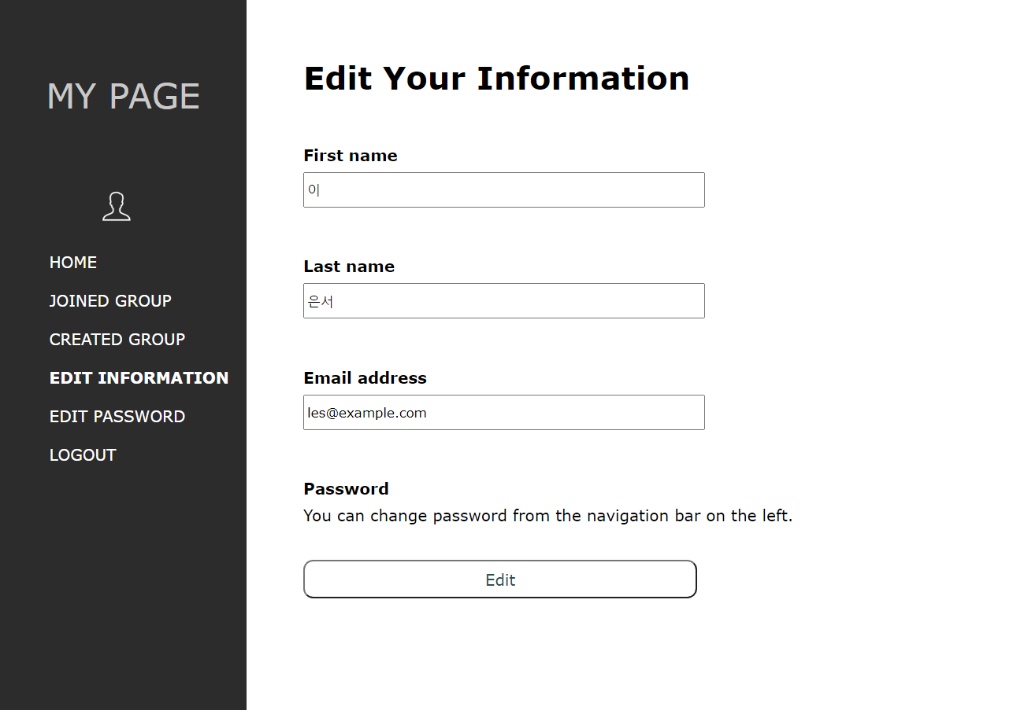
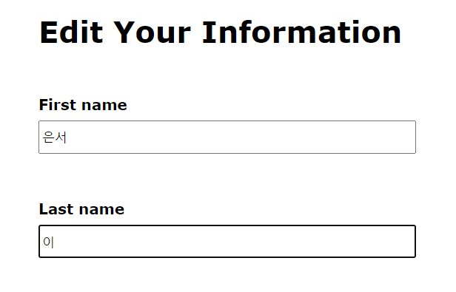
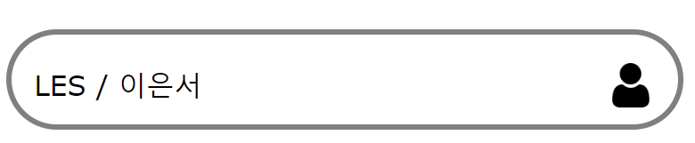
ShareShare – My page : Edit Info
Edit Info
My page provides editing user information functions.
Function
User can update ID, name, and address infomation.

Slide 23
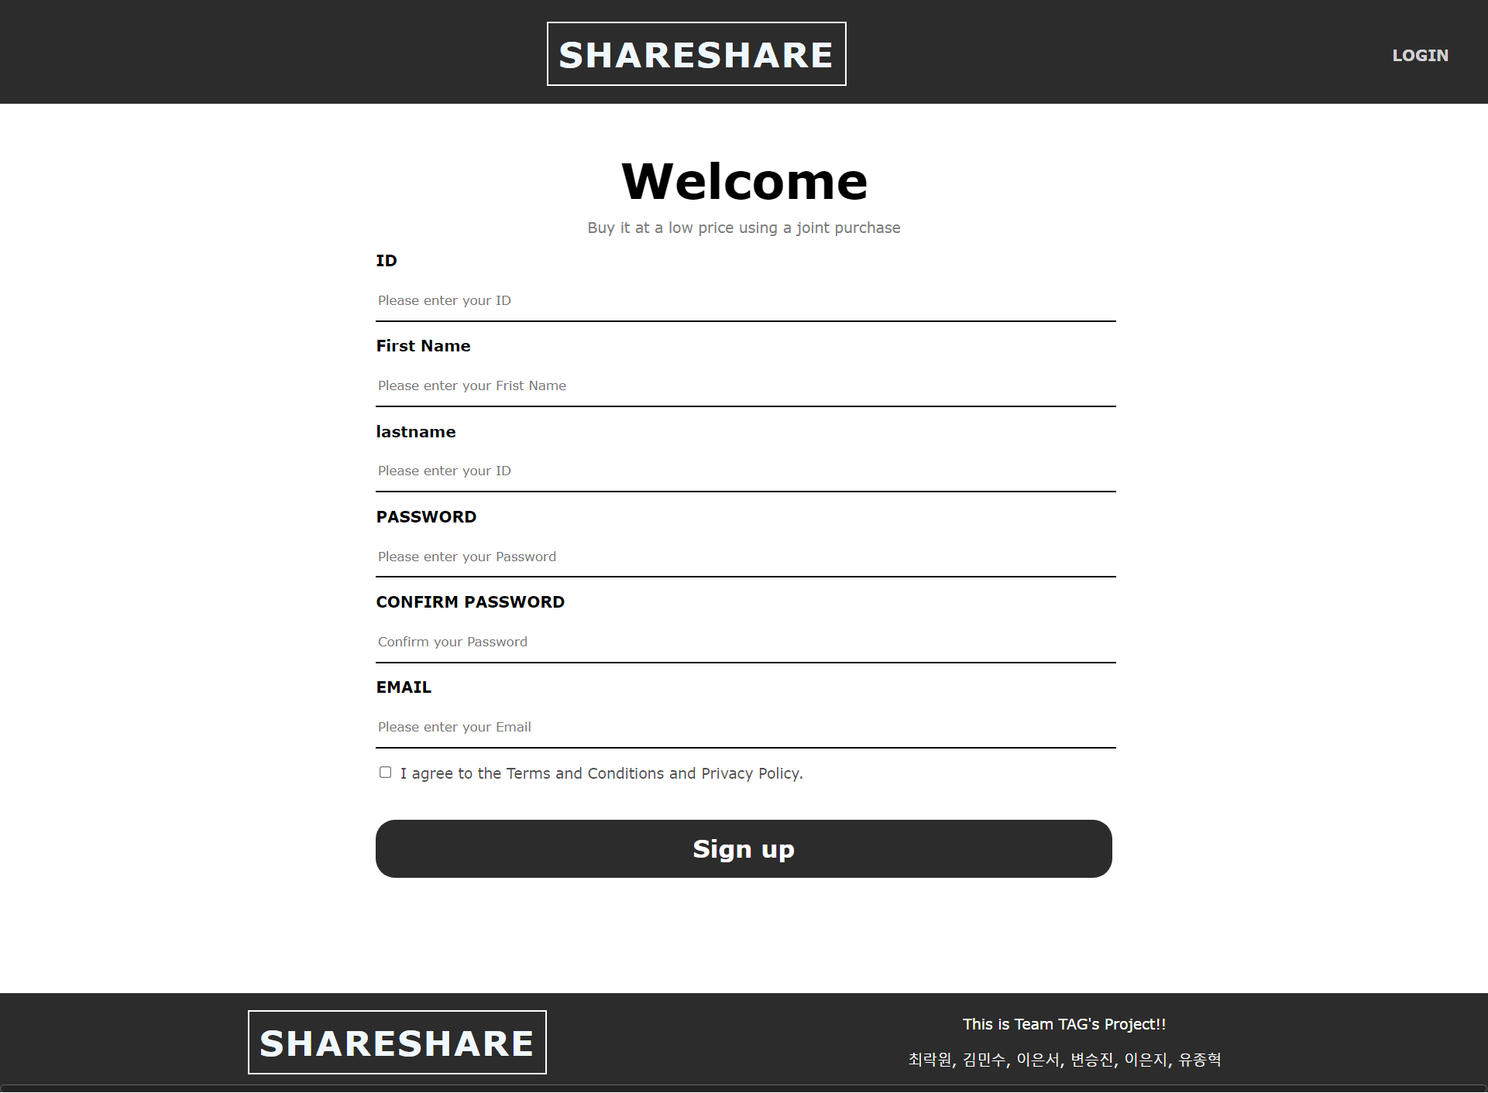
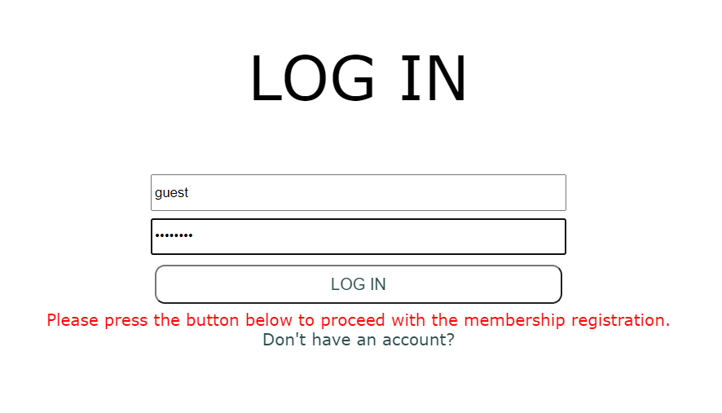
ShareShare – Login page
Login Page
To use ShareShare, user should log in via login page.
It demands ID and passwords.
Function
If user have no account, they can sign up when click the script.

Slide 24
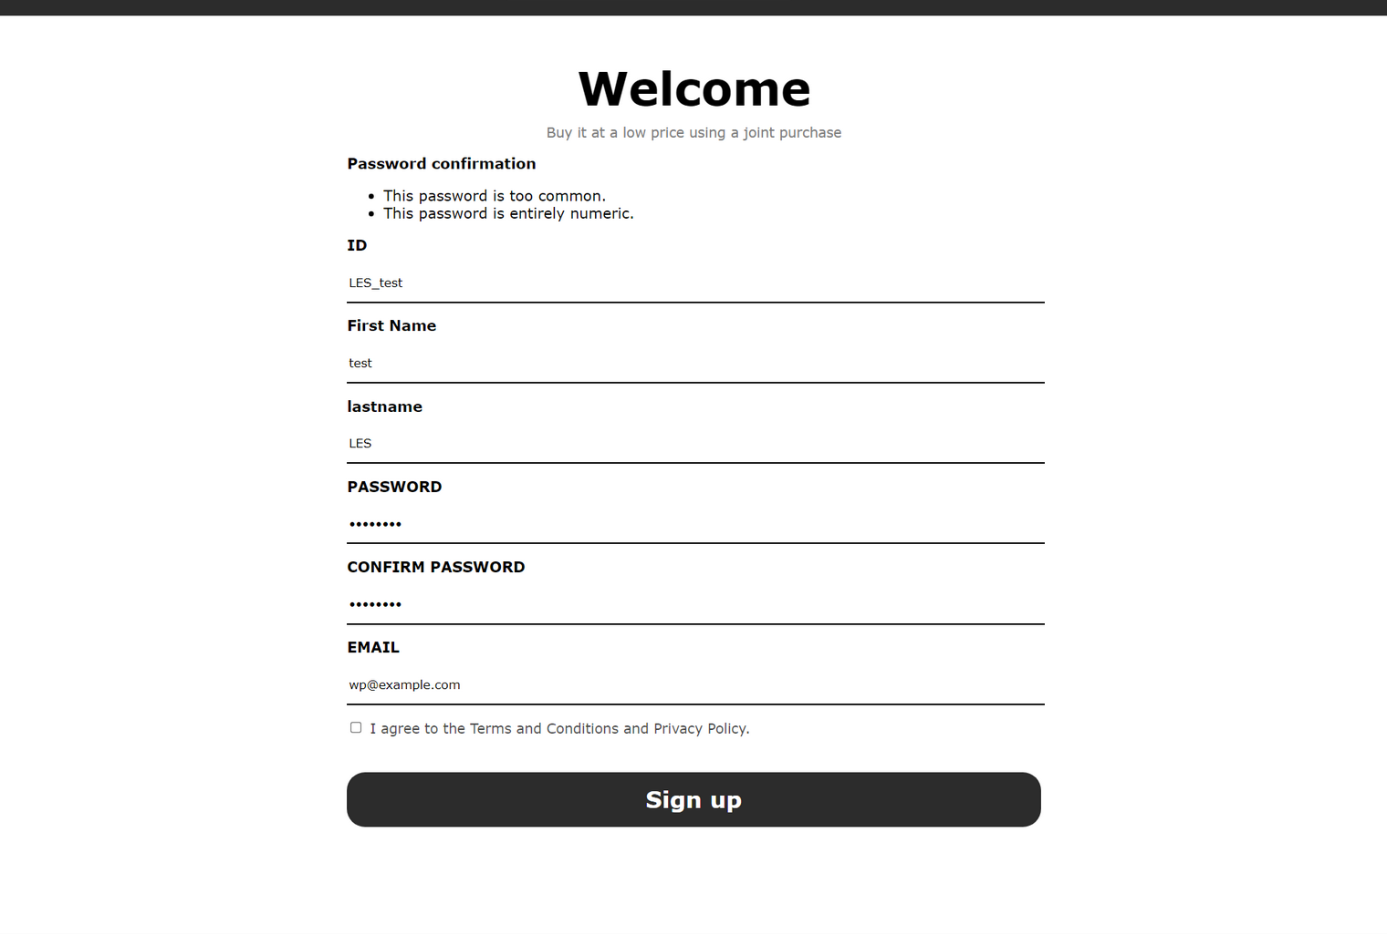
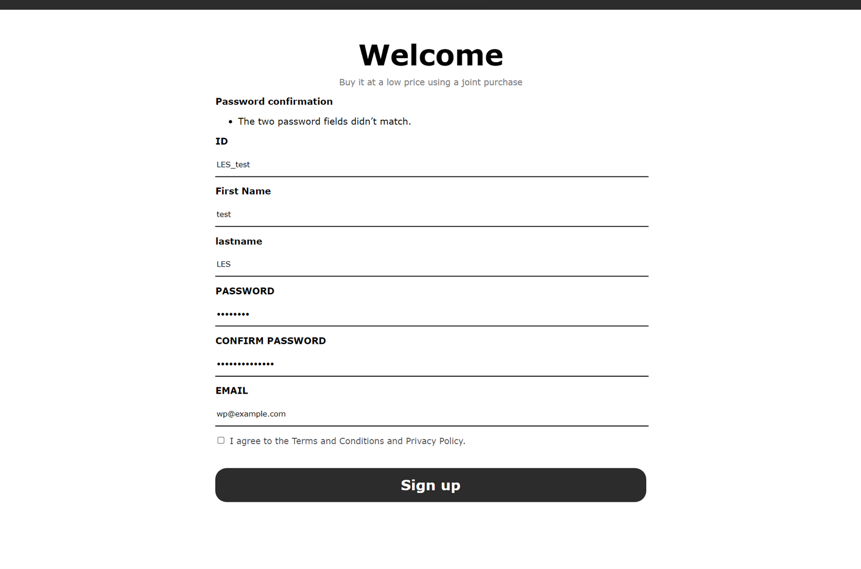
ShareShare – Sign Up page
Sign Up Page
To use ShareShare, user should log in via login page.
It demands ID and passwords.
Function
If user have no account, they can sign up when click the script.
If the password is wrong or too simple, It blocks user to sign up and shows the alert.

Slide 25
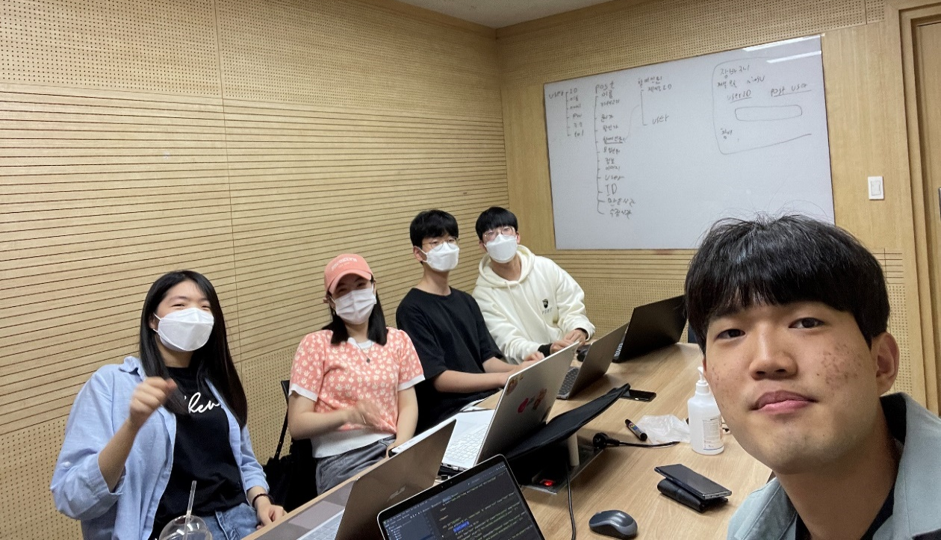
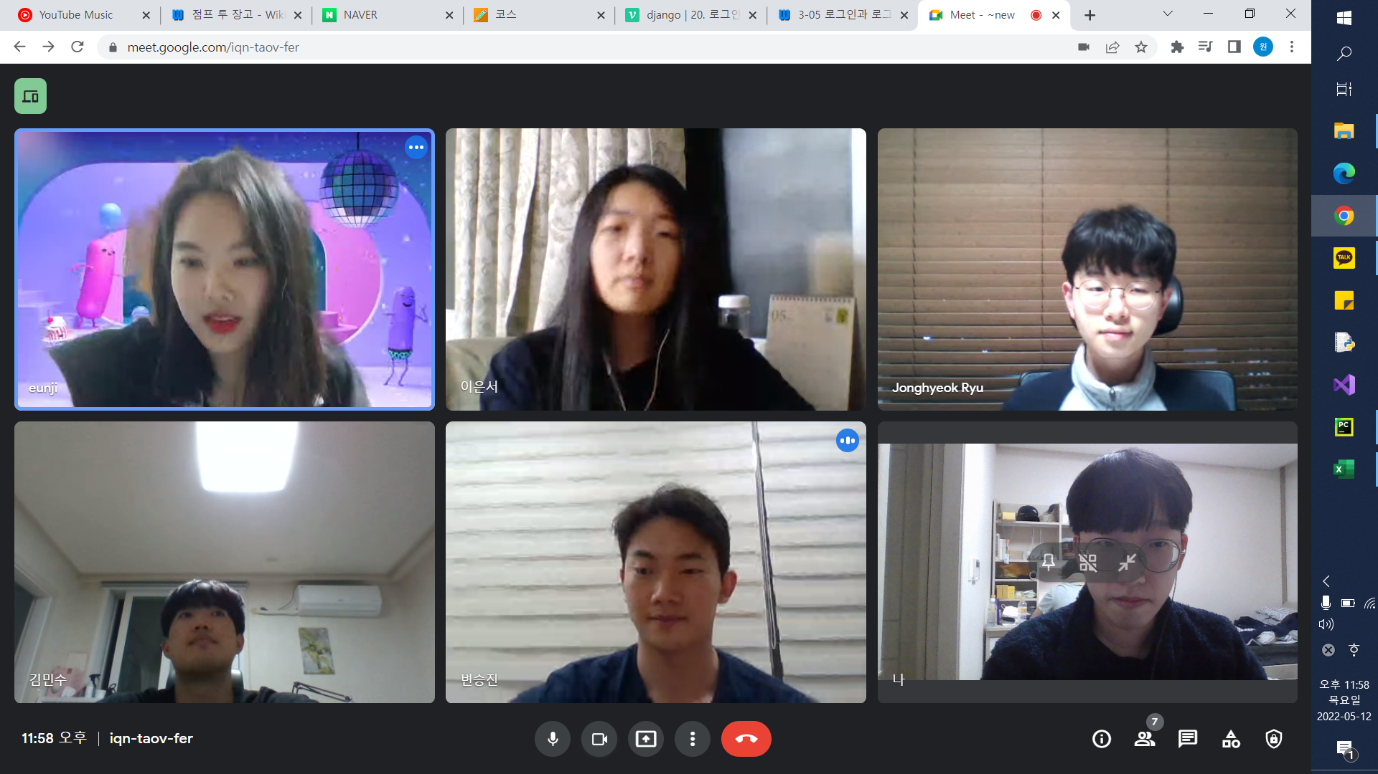
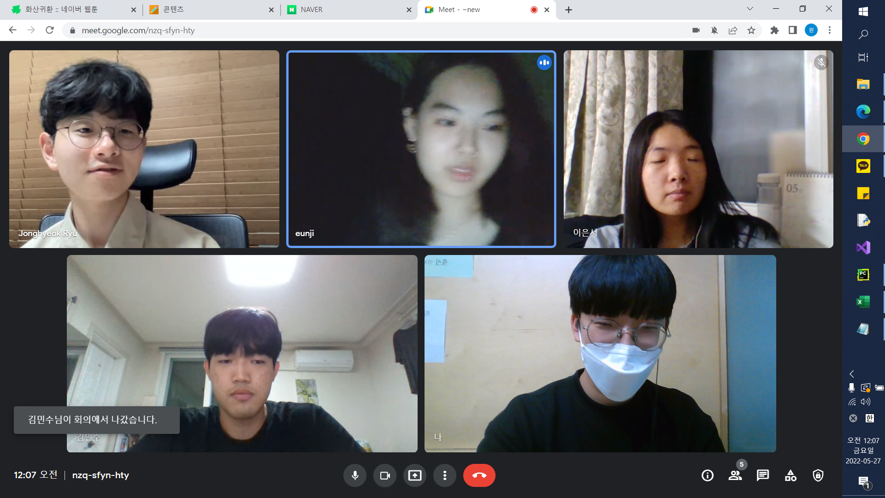
제작 과정
Process – our group meetings

Slide 26
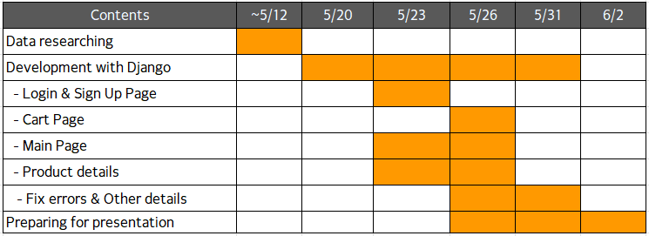
Process – Time Table

Slide 27
Thank you!
Next will be a
Q&A

